Slide 1



C Chess Game Implementation Overview
This C program implements a text-based chess game. It enables player-vs-bot gameplay, featuring board initialization, move validation, and checkmate detection. The code structure emphasizes modularity and follows chess rules closely.
by ChessBot Team
Notes:
1.7.2013
1
‹#›

Slide 2
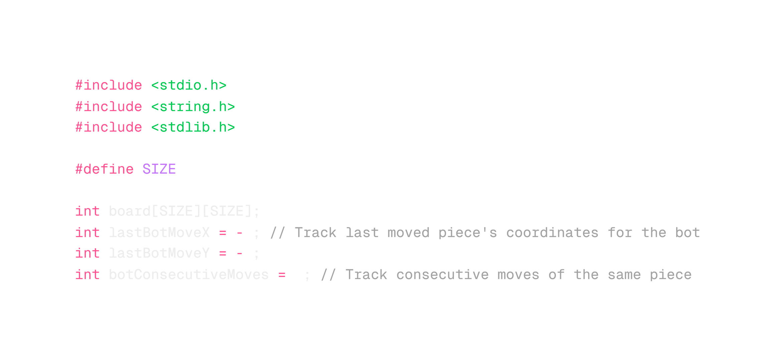
Notes:
1.7.2013
1
‹#›

Slide 3
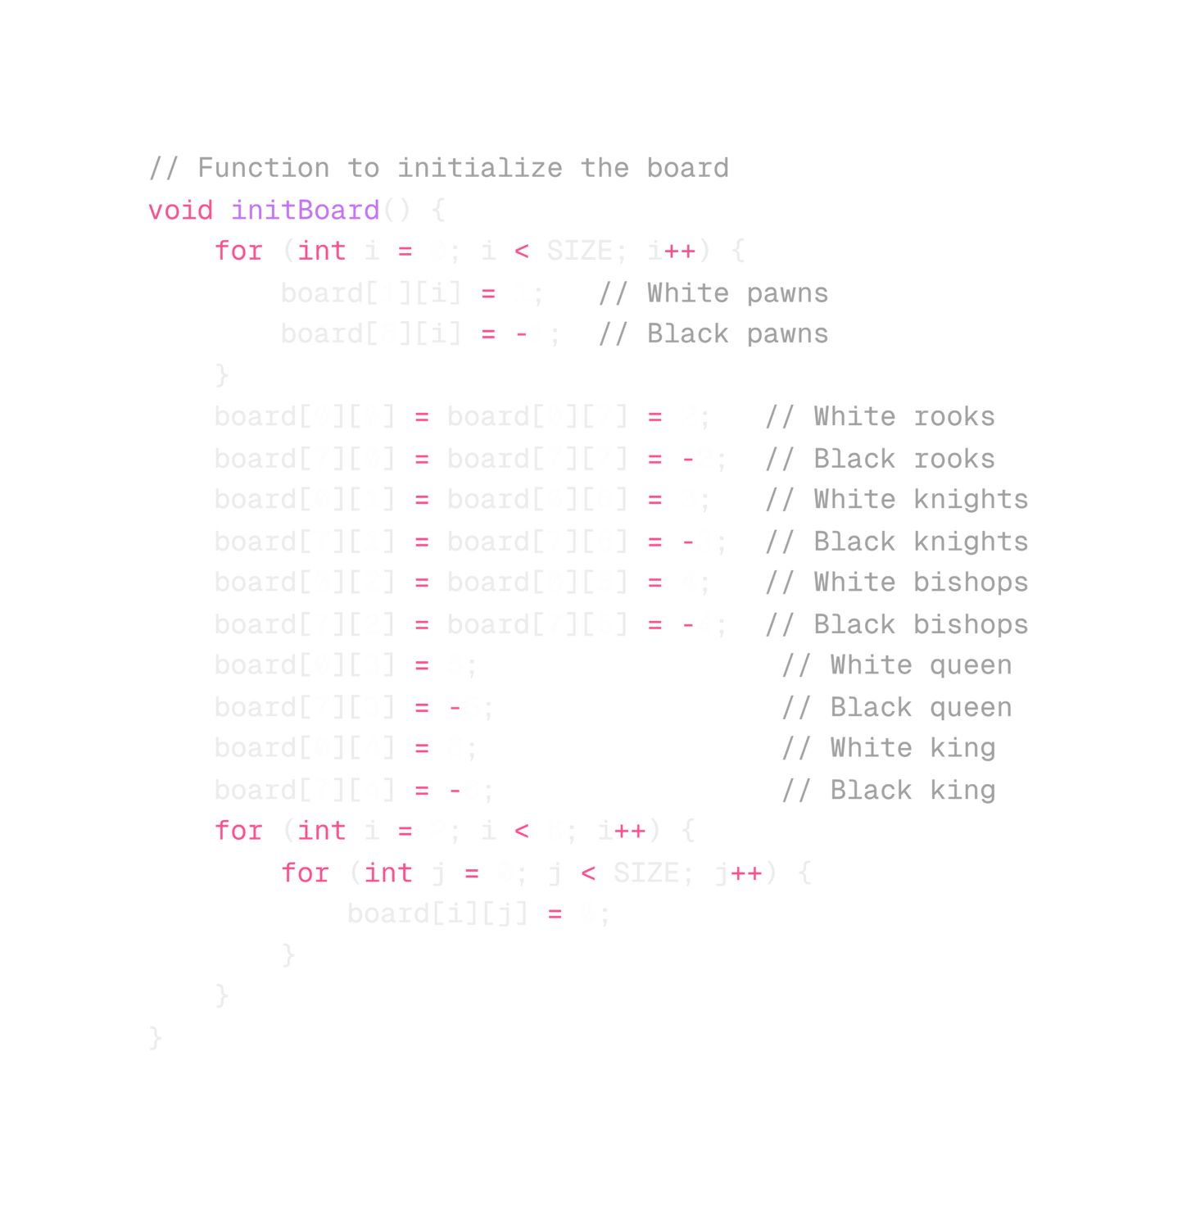
Notes:
1.7.2013
1
‹#›

Slide 4
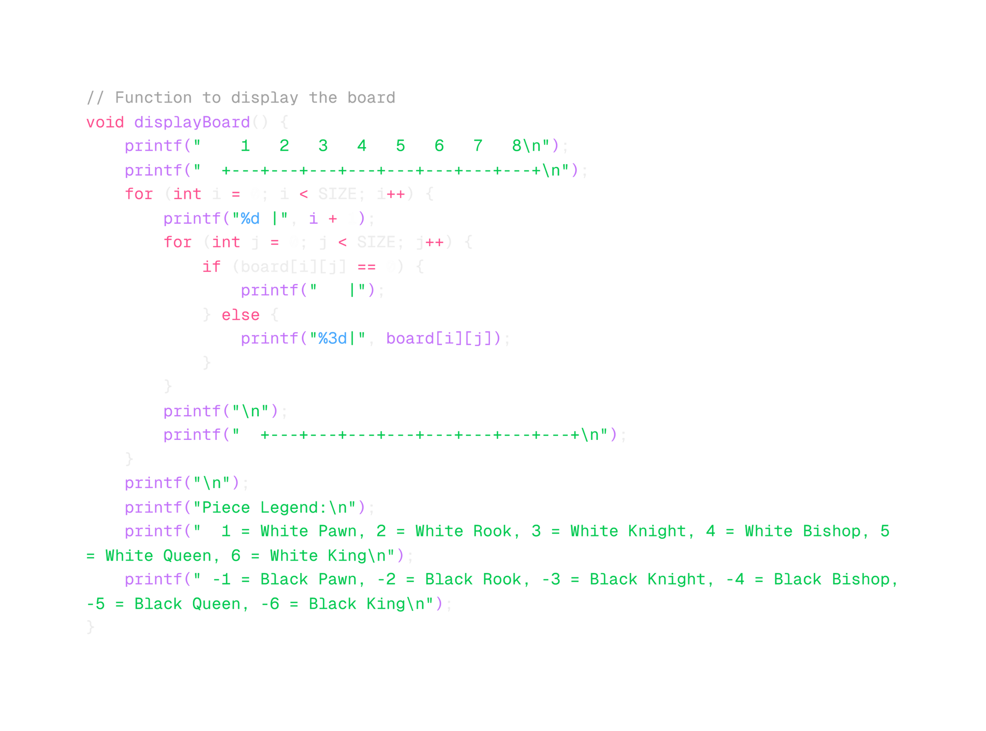
Notes:
1.7.2013
1
‹#›

Slide 5
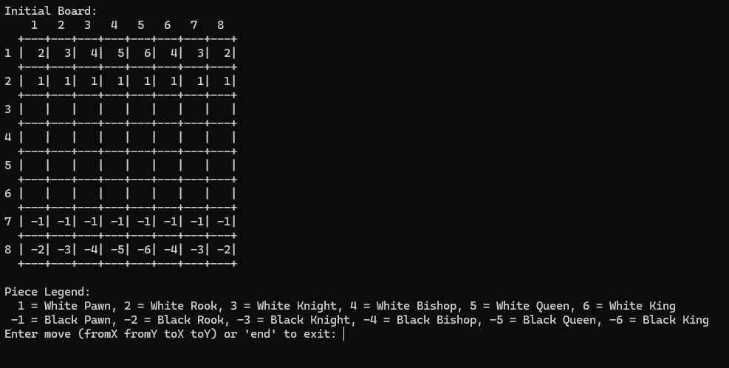
Notes:
1.7.2013
1
‹#›

Slide 6
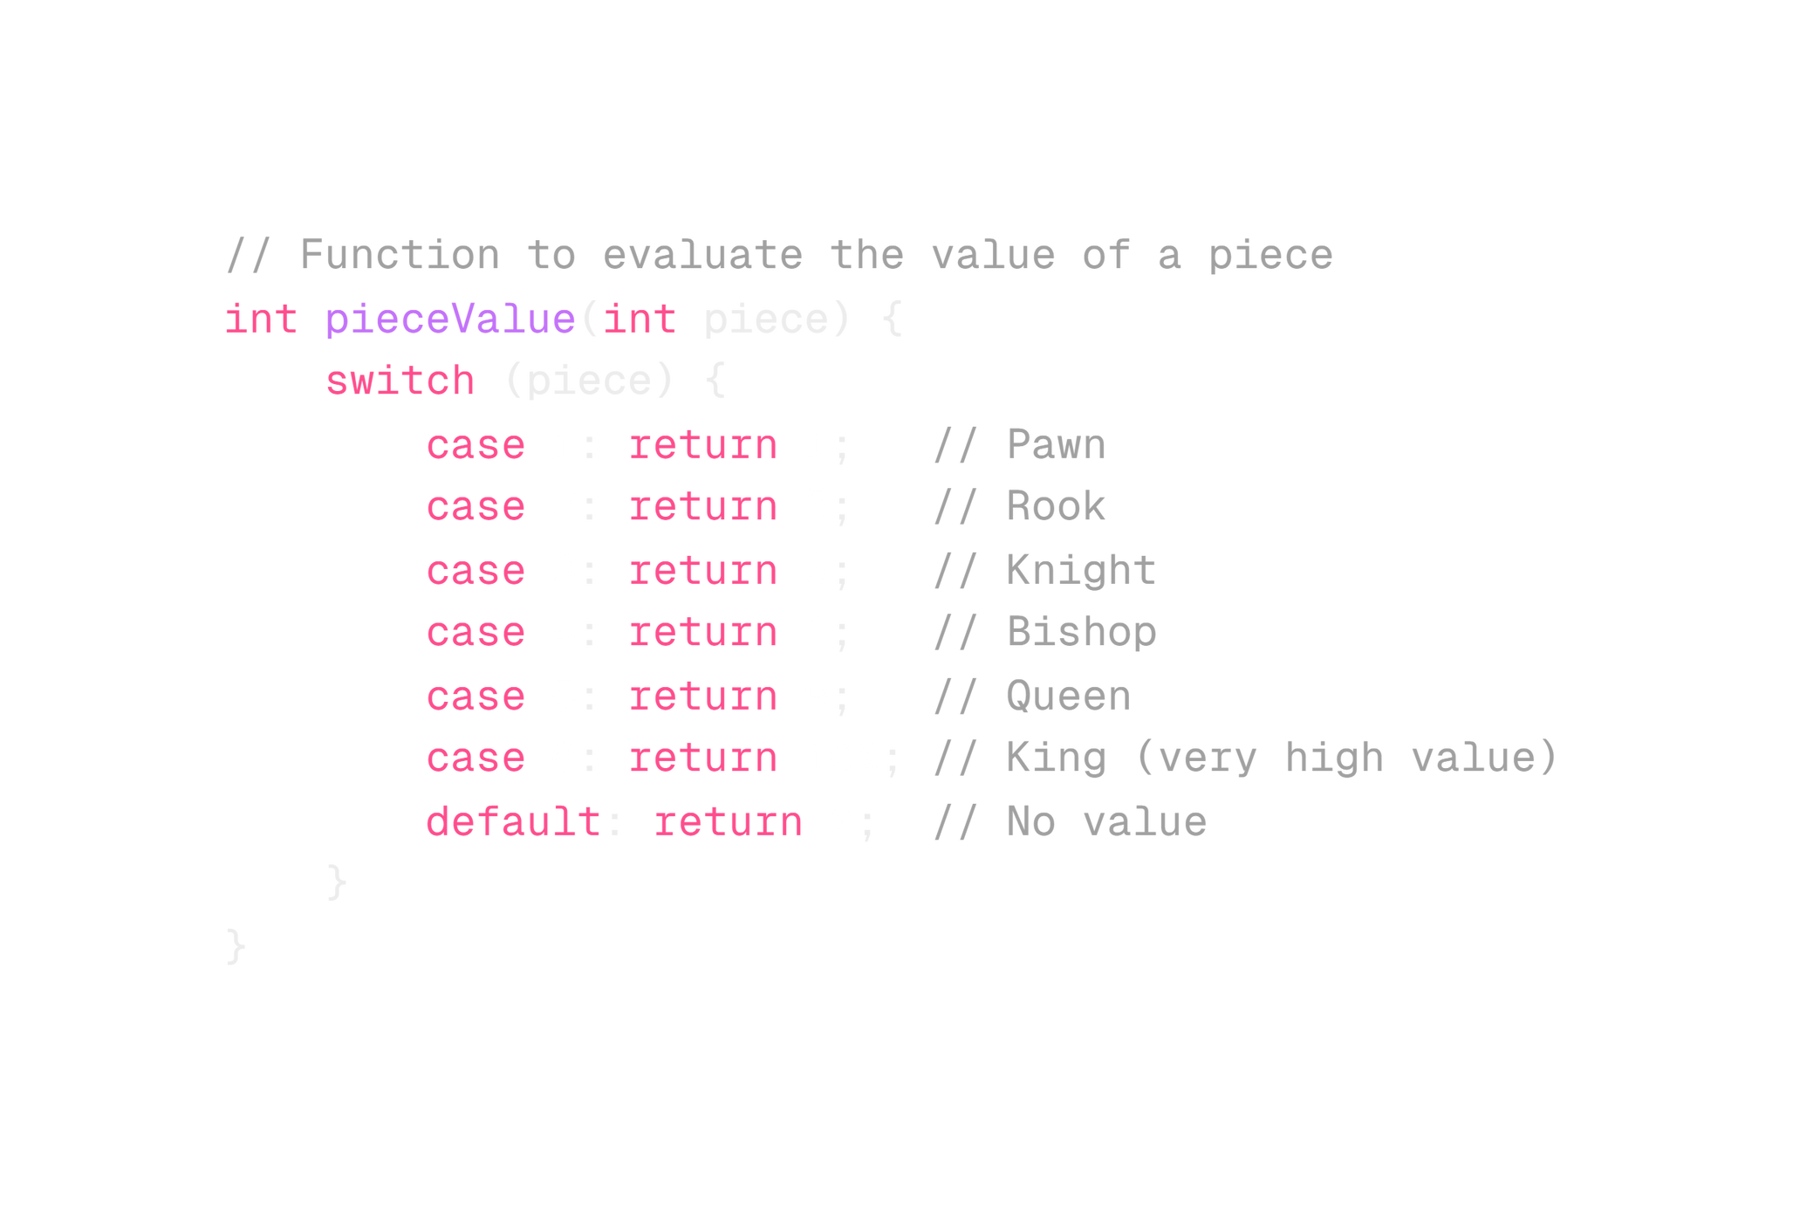
Notes:
1.7.2013
1
‹#›

Slide 7

Move Validation Functions
1
Piece-Specific Validation
Separate functions for each piece type (e.g., isValidPawnMove, isValidRookMove). Ensures moves adhere to chess rules.
Notes:
1.7.2013
3
‹#›

Slide 8

Notes:
1.7.2013
1
‹#›

Slide 9
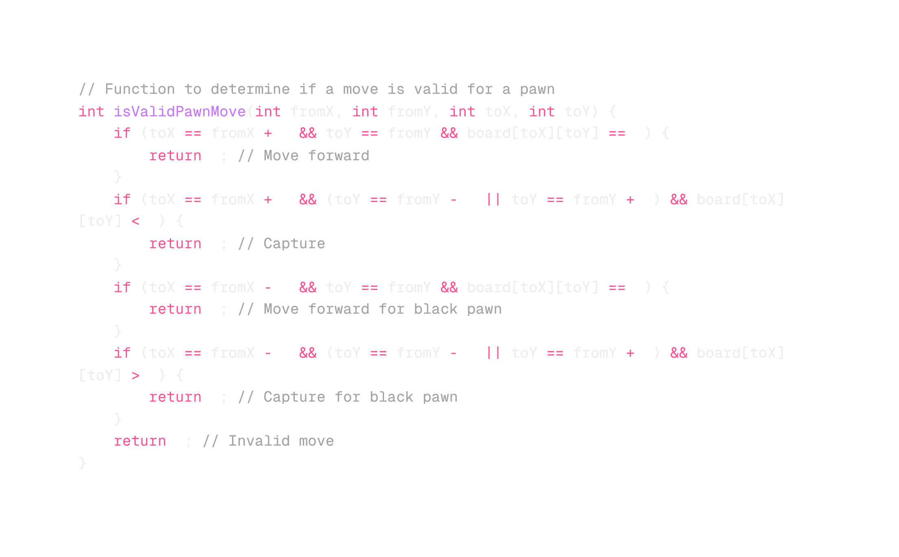
Notes:
1.7.2013
1
‹#›

Slide 10
Notes:
1.7.2013
1
‹#›

Slide 11
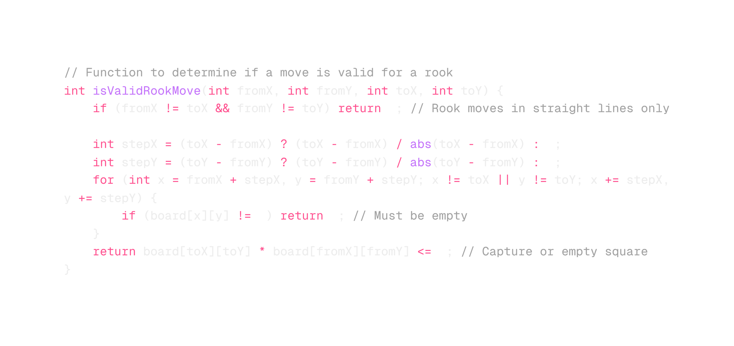
Notes:
1.7.2013
1
‹#›

Slide 12
Notes:
1.7.2013
1
‹#›

Slide 13
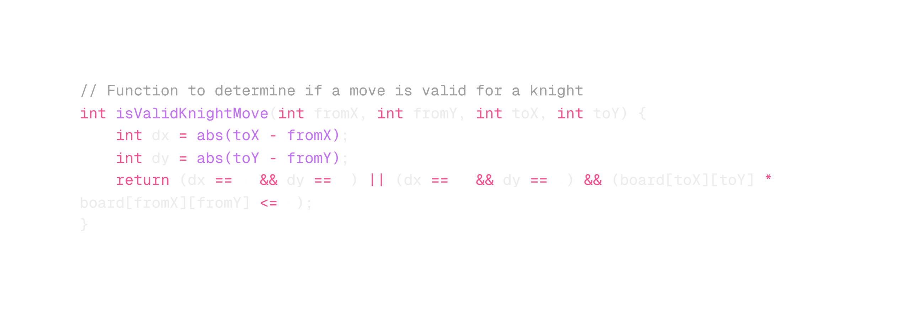
Notes:
1.7.2013
1
‹#›

Slide 14
Notes:
1.7.2013
1
‹#›

Slide 15
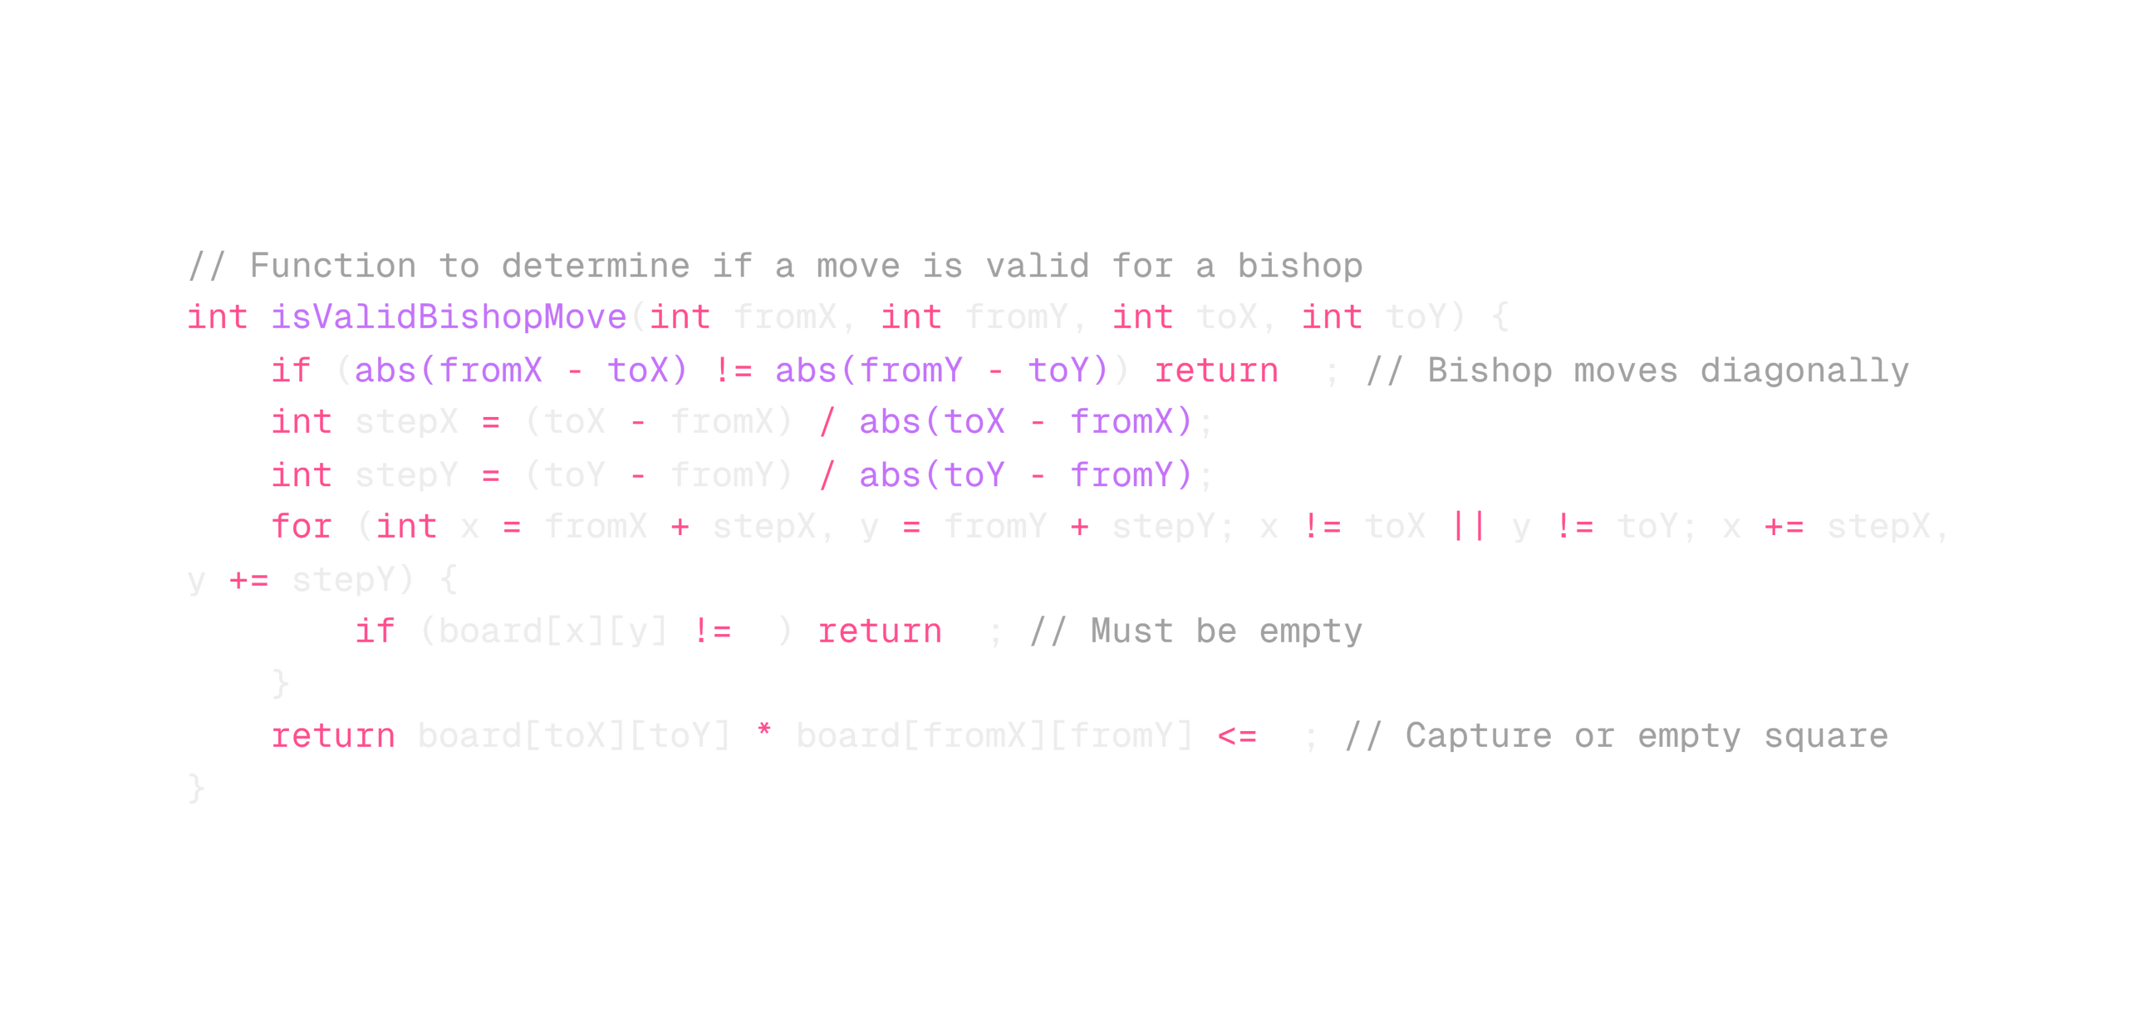
Notes:
1.7.2013
1
‹#›

Slide 16
Notes:
1.7.2013
1
‹#›

Slide 17
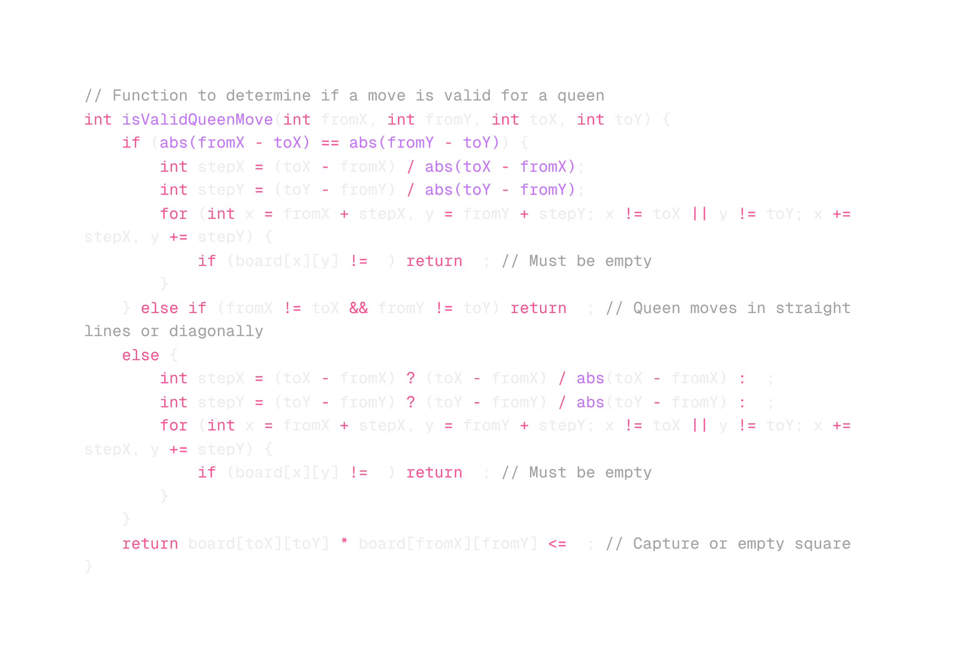
Notes:
1.7.2013
1
‹#›

Slide 18
Notes:
1.7.2013
1
‹#›

Slide 19
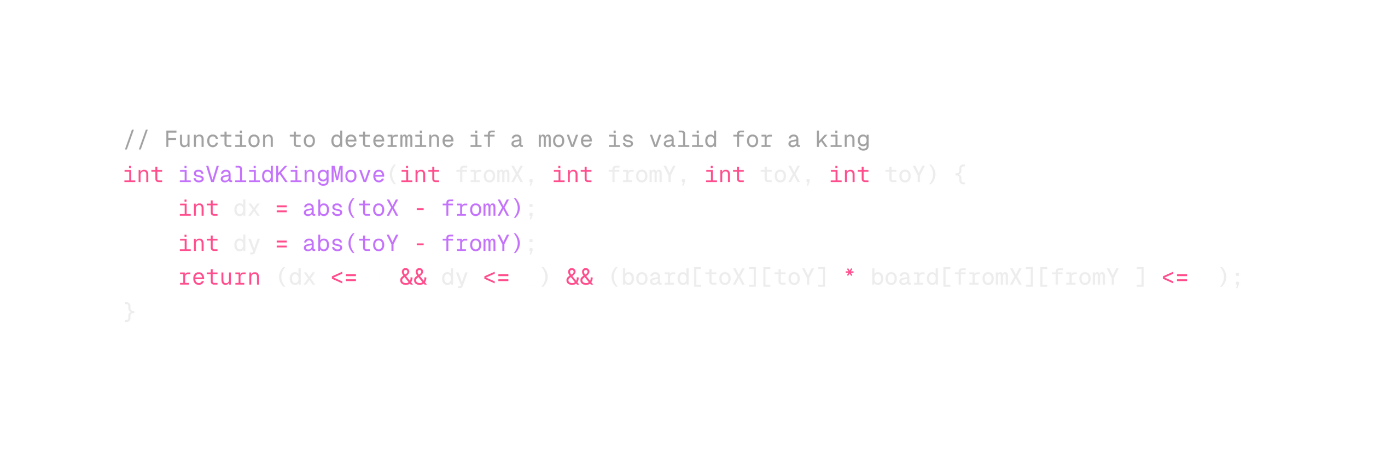
Notes:
1.7.2013
1
‹#›

Slide 20
Move Validation Functions
2
canMove()
General move validation function. Calls piece-specific functions based on the moving piece's type.
Notes:
1.7.2013
3
‹#›

Slide 21
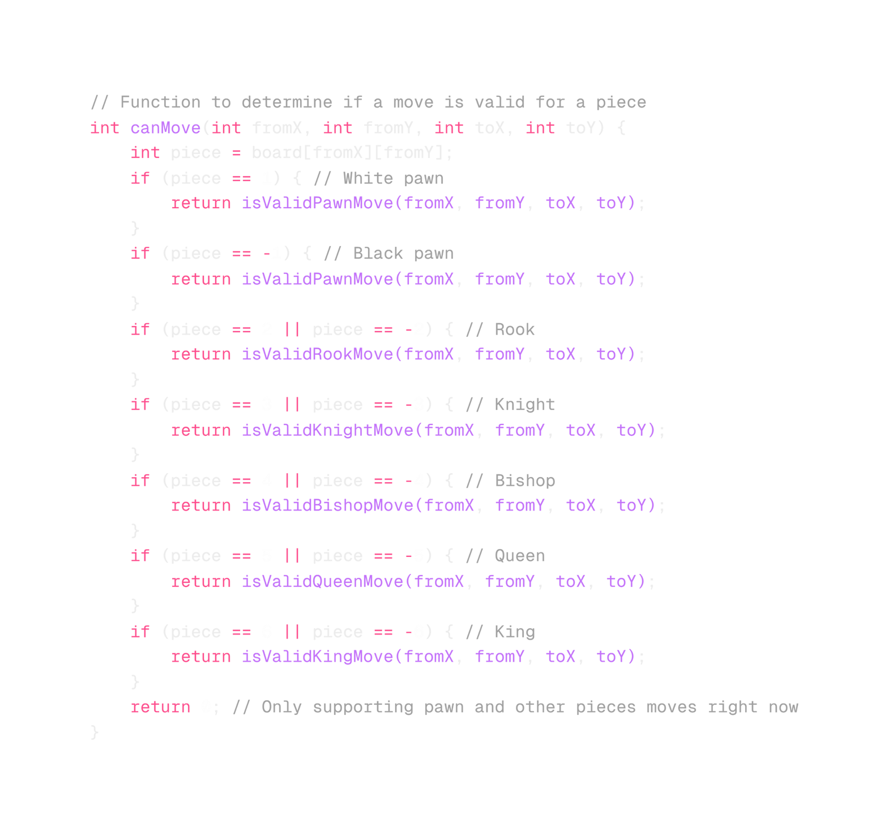
Notes:
1.7.2013
1
‹#›

Slide 22

Bot AI Implementation
Piece Evaluation
1
Bot assesses potential moves based on piece values and strategic considerations.
Move Selection
2
Chooses the highest-scoring move. Implements a basic rule to avoid repetitive moves.
Execution
3
Bot executes the selected move, updating the board state accordingly.
Notes:
1.7.2013
4
‹#›

Slide 23
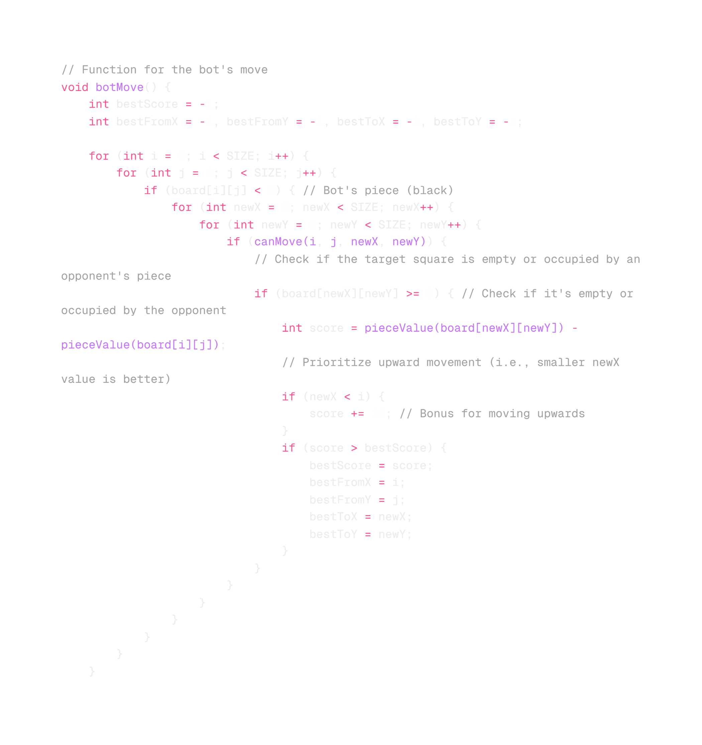
Notes:
1.7.2013
1
‹#›

Slide 24
Notes:
1.7.2013
1
‹#›

Slide 25
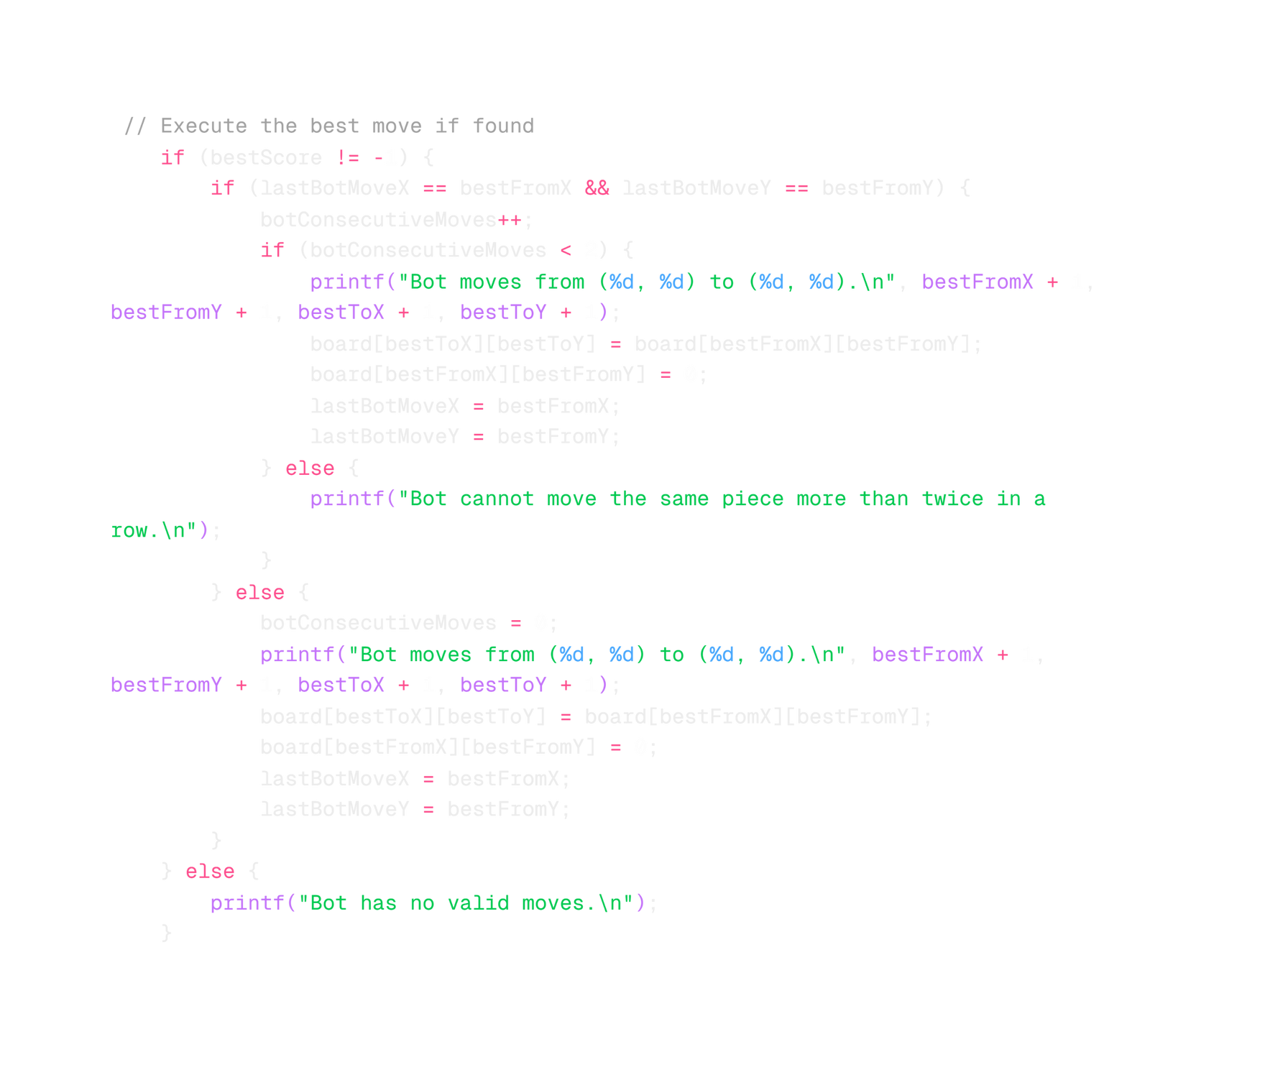
Notes:
1.7.2013
1
‹#›

Slide 26
Move Validation Functions
3
isAttacked()
Checks if a square is under threat. Crucial for implementing check and checkmate logic.
Notes:
1.7.2013
3
‹#›

Slide 27
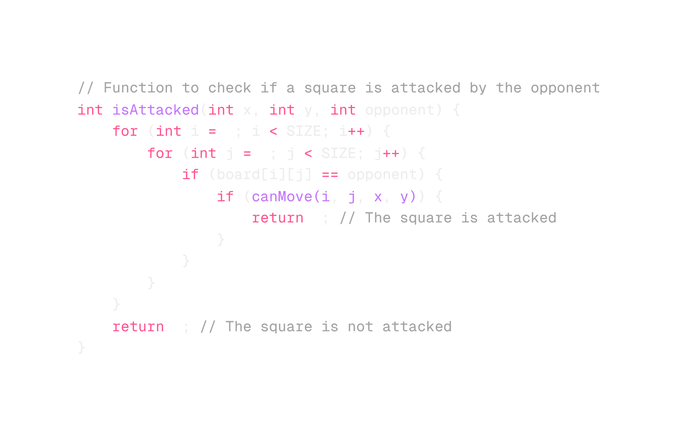
Notes:
1.7.2013
1
‹#›

Slide 28
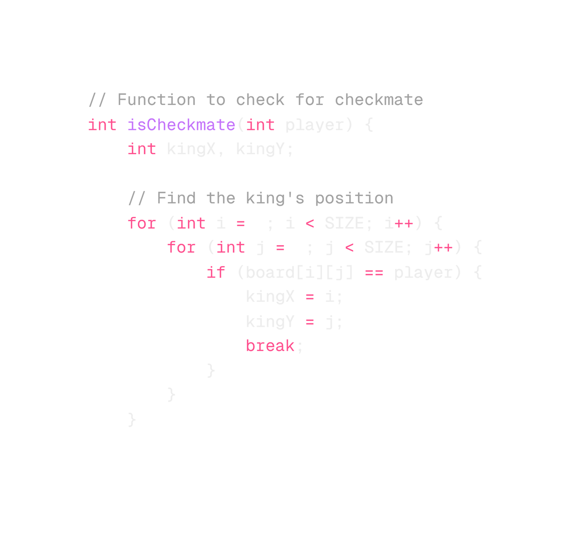
Notes:
1.7.2013
1
‹#›

Slide 29
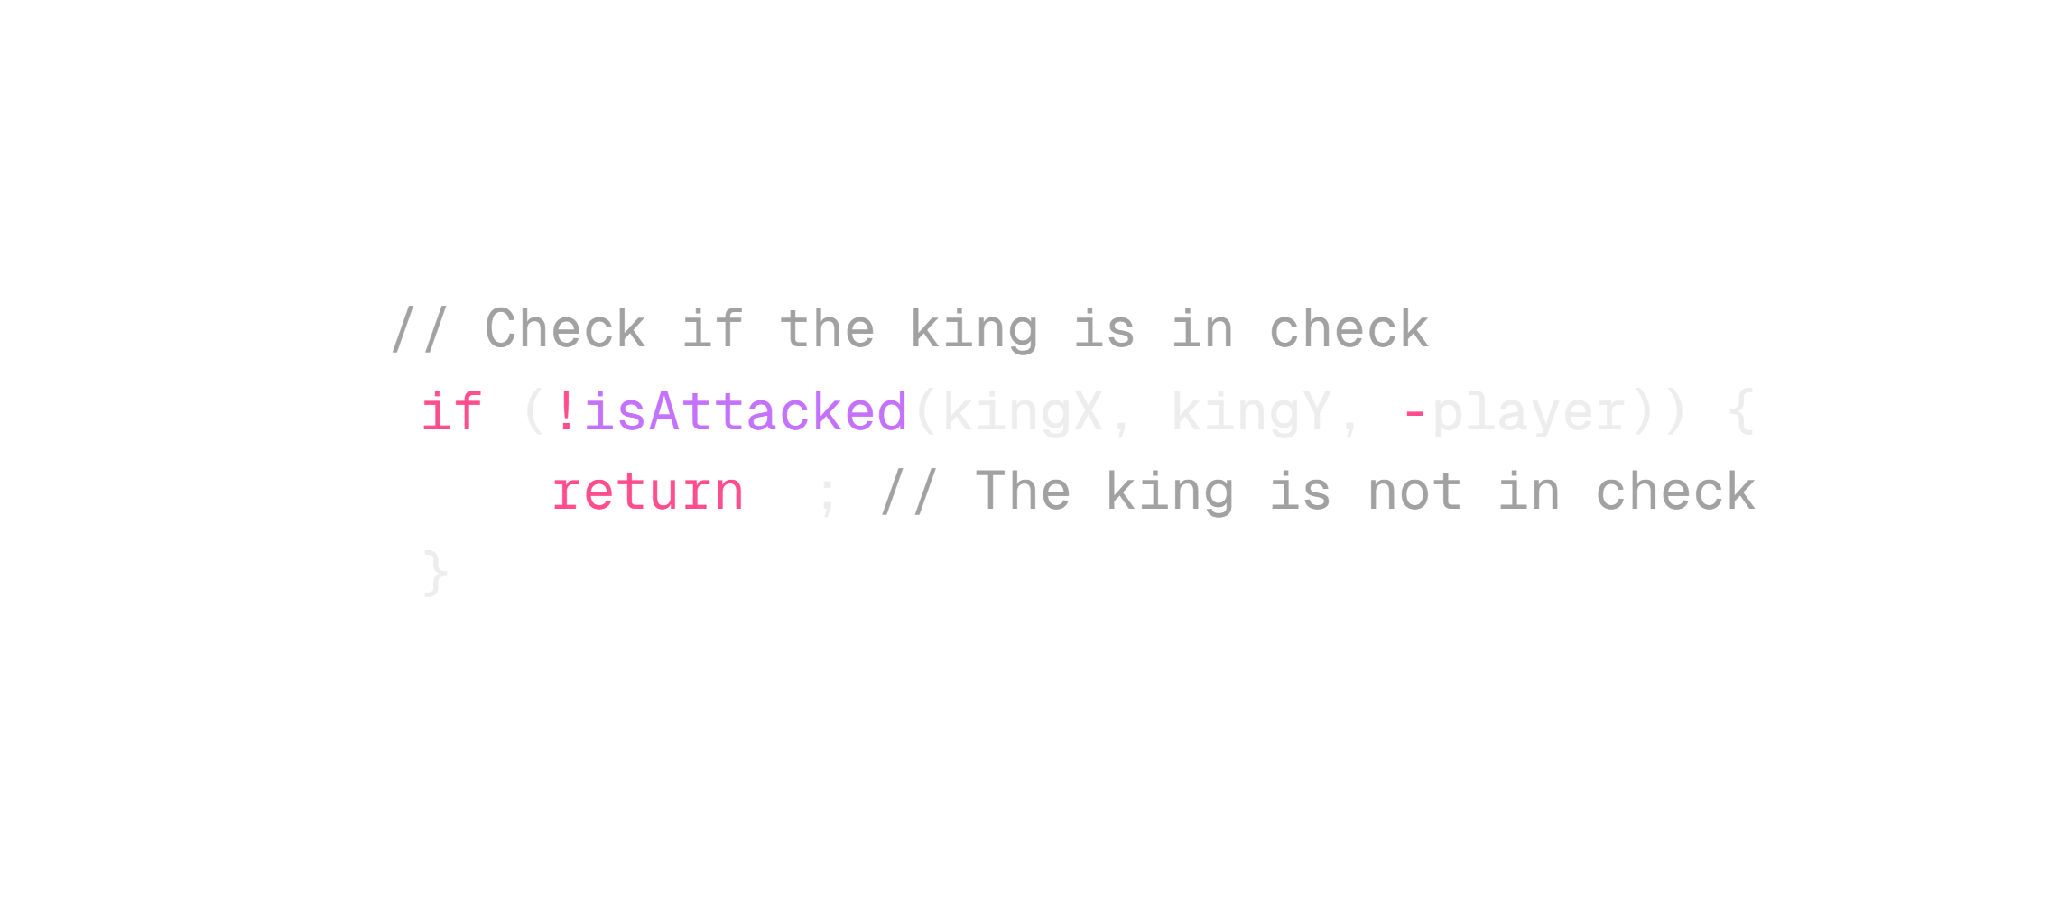
Notes:
1.7.2013
1
‹#›

Slide 30
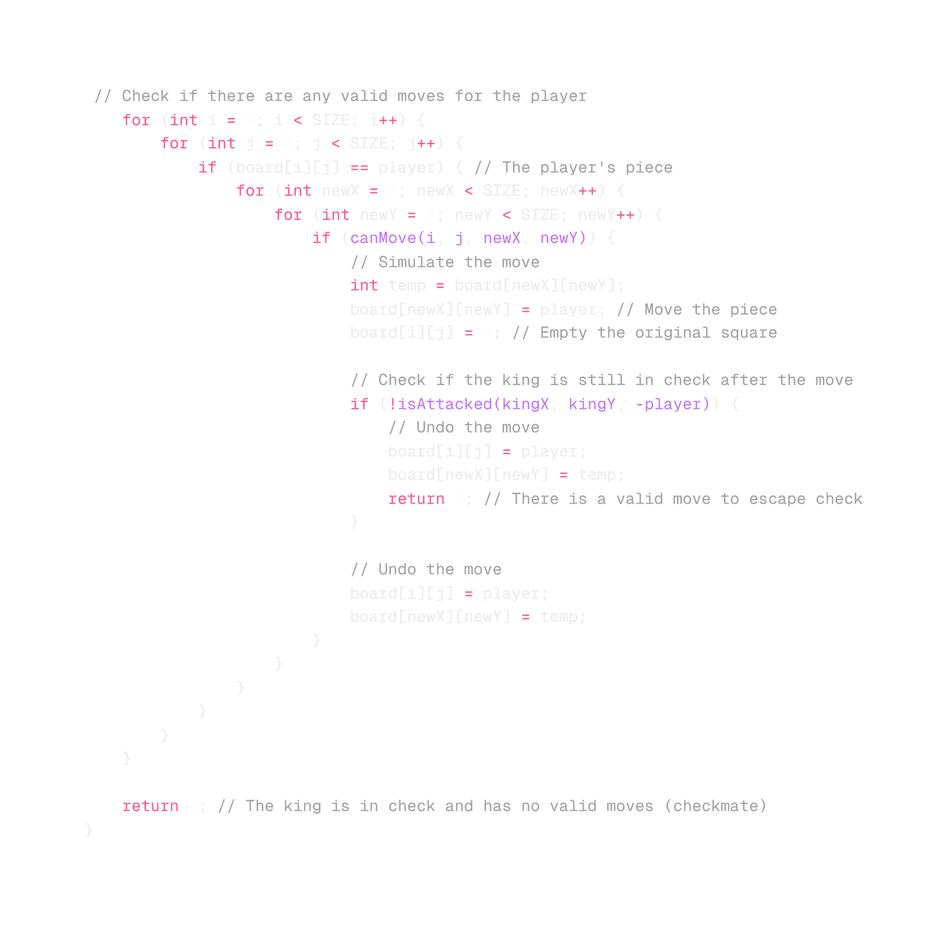
Notes:
1.7.2013
1
‹#›

Slide 31




Game Flow and Win Conditions
Player Move
Bot Move
Checkmate Check
User inputs move. Program validates and executes if legal.
AI selects and executes move. Board updates after each turn.
Program checks for checkmate after each move. Game ends if detected.
Notes:
1.7.2013
5
‹#›

Slide 32
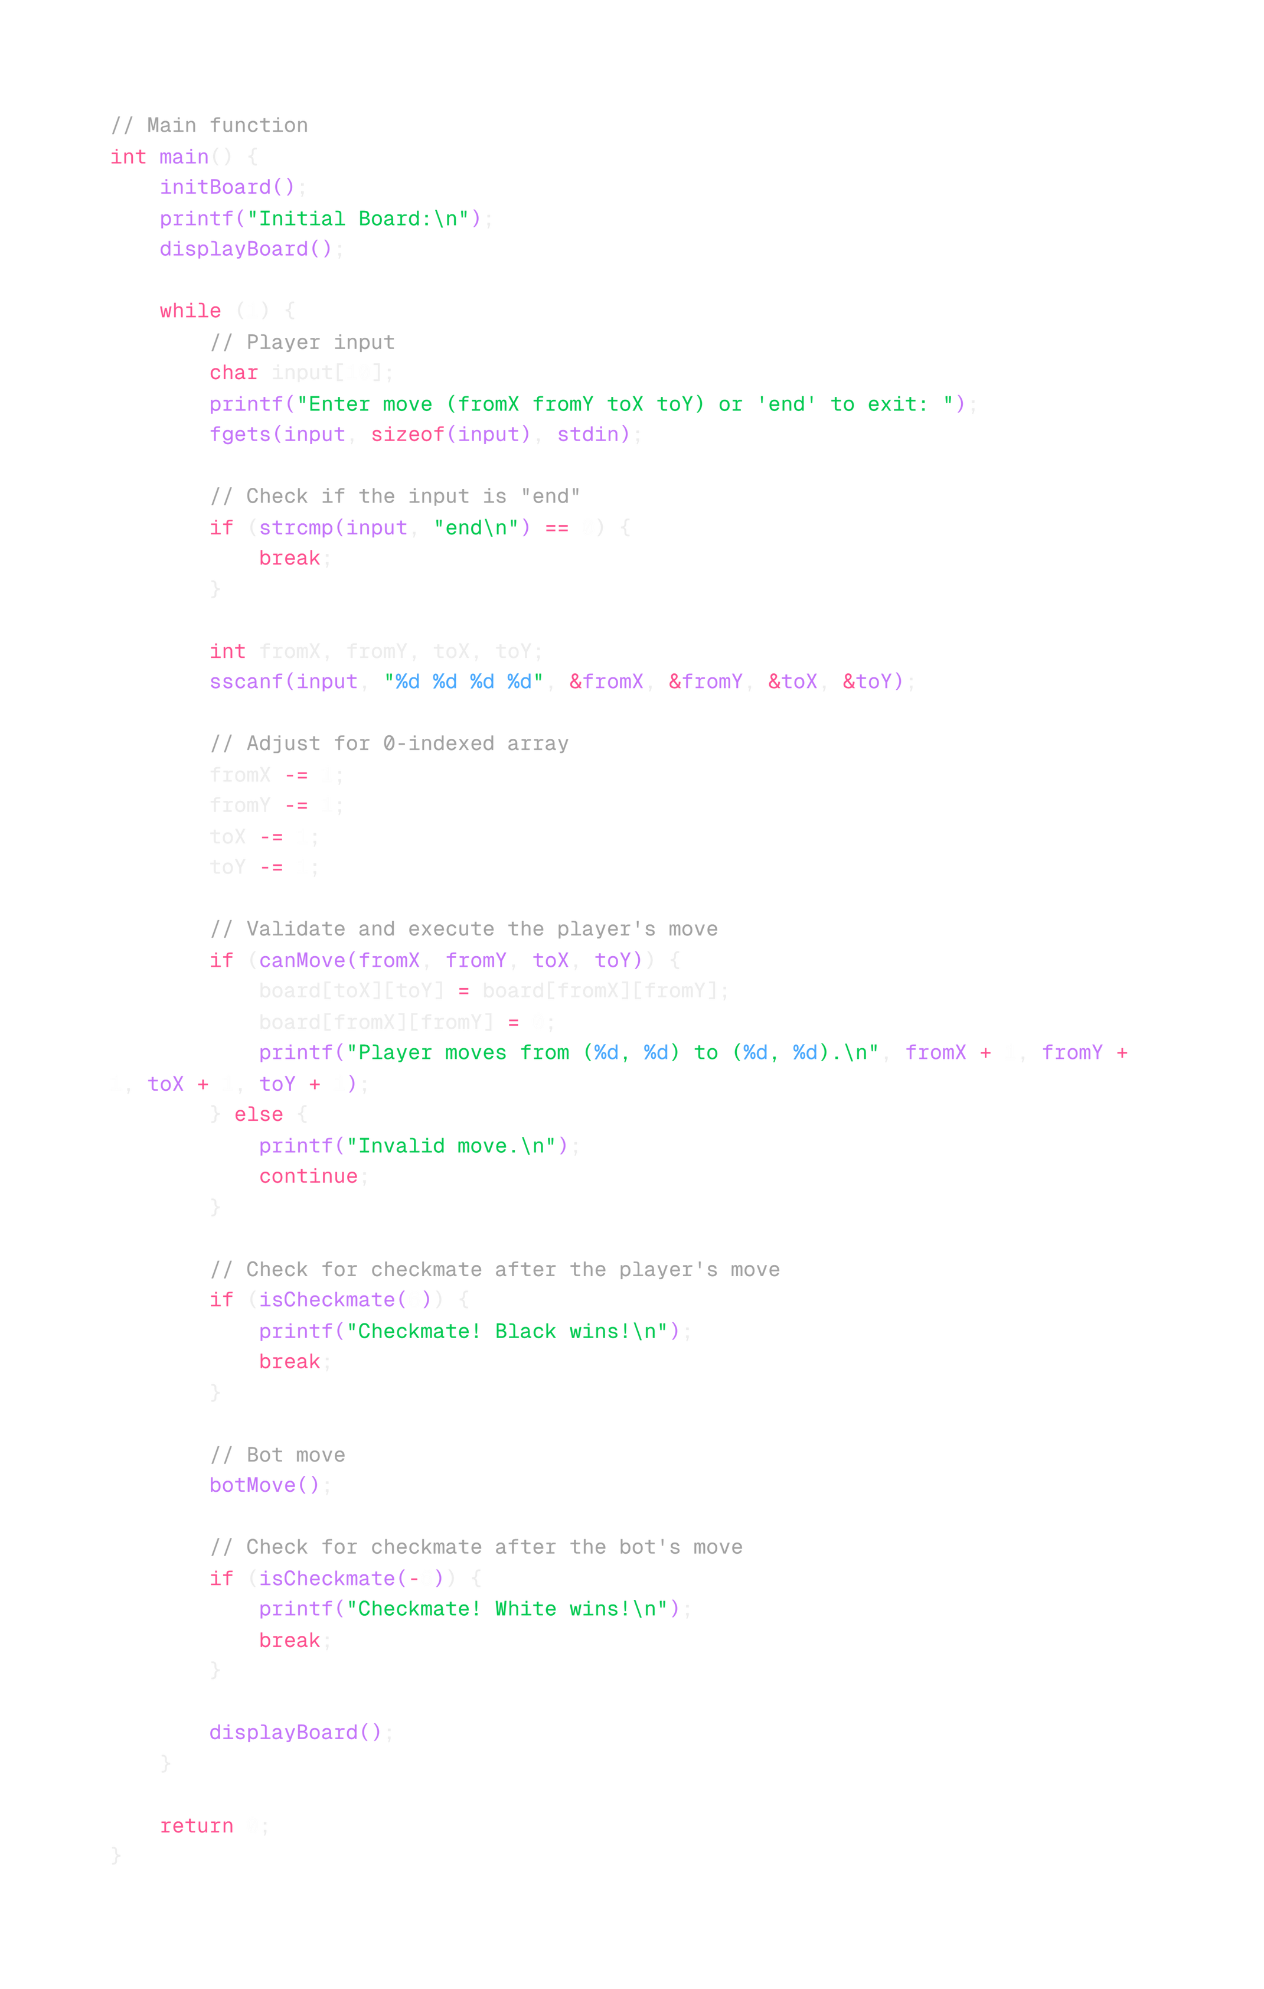
Notes:
1.7.2013
1
‹#›

Slide 33
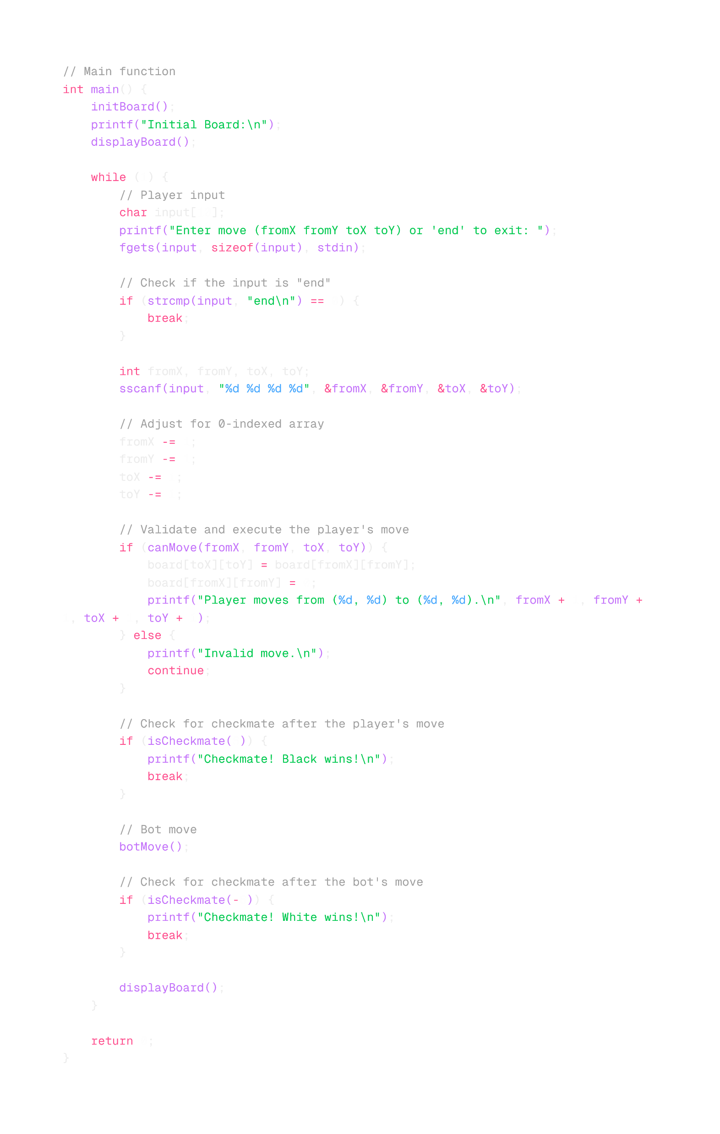
Notes:
1.7.2013
1
‹#›

Slide 34




Potential Enhancements
Advanced AI
Implement more sophisticated decision-making algorithms for the bot player.
Move History
Add functionality to undo moves and review game history.
Networking
Implement multiplayer functionality for online chess matches.
Notes:
1.7.2013
6
‹#›

Slide 35
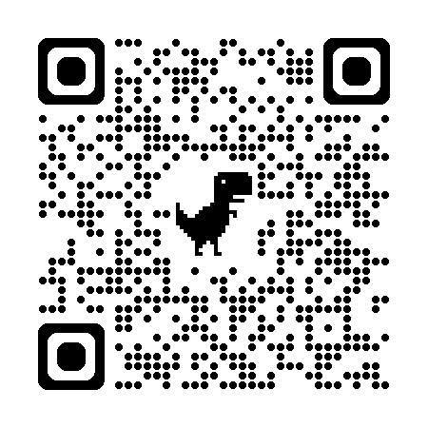
QR Code to GitHub:
Notes:
1.7.2013
6
‹#›

